Slide 1
Machine Learning Trade Predictor
Damani Walker

Slide 2
Purpose?
The goal of this Project is to give investors clear signals on when to buy/sell stocks using machine learning models.
Originally, a Monte Carlo simulation was going to be used in order to determine when the best time in the future to buy/sell stocks
Instead, we took the current return at a specific point in time and shifted it back 30 days to see if machine learning models could predict future returns

Slide 3
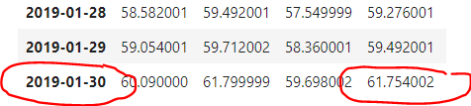
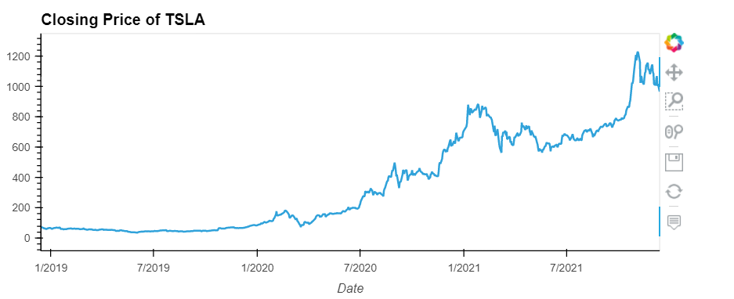
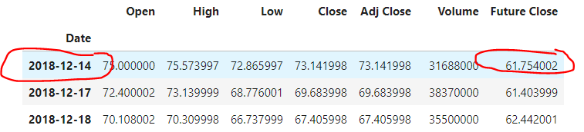
Data and Model Training
Added a column for “Future Close” which takes the closing price 30 days after the first and sets it to the beginning.
Data is gathered from historical csv’s
We calculate the returns for the stock to see the general trajectory.

Slide 4
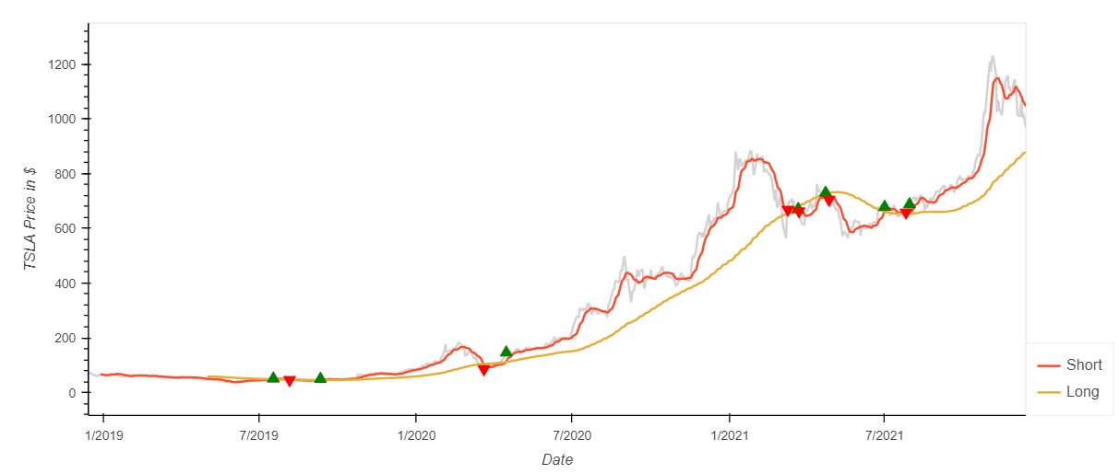
Data and Model Training (cont’d)
Then added the “Short” and “Long” columns to serve as a feature for the upcoming signal
Used a short window of 10
Used a long window of 95
With this information, we can create our “Signal” column to determine when to buy/sell
Buy if Signal = 1
Sell iff Signal = -1
By using the diff() function we can visualize our entry/exit

Slide 5
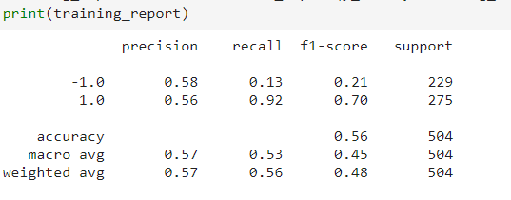
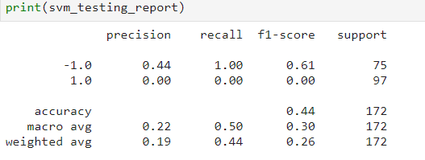
Model Evaluation & Discussion
Originally, a Support Vector Machine (SVM) Classifier was used:
However, as you can see from the results, it did not perform very well. The precision and recall were completely different in from the training data to the testing data.
This could most likely be due to the fact that there wasn’t enough data to support the model.
In the future, a different model will be used, such as an oversampling model or a balanced random forest model

Slide 6
Questions?
The End

